Slide 1
Chapter 9 Testing Hypotheses

Slide 2
Example: Average Gas Prices
Hypothesis
The average price of gas in California is higher than the average national price of gas
Notes:
We take a sample of N=100 gas stations in california and compare that to the national gas average.
We find that price in california sample is 3.90 and the average national is 3.53
Is this diff large enough to convince us that the sample from california is non-representative?
This diff can mean two things 1) that the average price in california is actually higher, or 2) the average price in california is about the same as national average, but the sample has a high mean

Slide 3
Hypothesis Testing
Allows us to evaluate hypotheses about population parameters based on sample statistics

Slide 4
Hypothesis Testing
Assumptions (that must be met)
The sample was randomly selected
The variable is measured at the interval-ratio level
The population is normally distributed (assumed if sample is N>50)

Slide 5
Hypothesis Testing
Testing the null hypothesis versus alternative hypotheses (various research hypotheses)
We are testing whether or not the null hypothesis is true.
We are trying to reject the null hypotheses in favor of our research hypothesis or hypotheses

Slide 6
Hypothesis Testing (Important)
With Z tests and t-tests, we are testing differences in means.
In Z-tests, we test whether or not our sample mean differs from the population mean (when we know the population standard error)
In a one-sample t-test, we test whether or not our sample mean differs from the population mean (when we don’t know the population standard error)
In a two-sample or independent samples t-test, we test whether or not one of our sample means differs from another sample mean (e.g. men vs. women)

Slide 7

The Null Hypothesis (H₀)
A statement that contradicts the research hypothesis
Is always expressed in terms of population parameters
Says there is “no mean difference” between the population mean and the sample mean or that there is “no relationship” between the two variables
Notes:
So using our example, the null is that there is no diff between mean price of gas in california and national mean of gas prices

Slide 8
The Research Hypothesis (H₁)
A statement reflecting the substantive hypothesis
It is always expressed in terms of population parameters, but its specific form varies from test to test

Slide 9

Example: The Research Hypothesis (H₁)
The average price of gas in California is higher than the average price of gas nationally

Slide 10
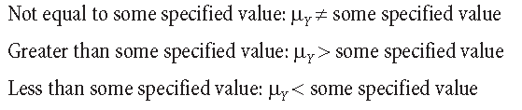
The Research Hypothesis (H₁)
The research hypothesis can be one of three things:
Two-tailed
One-tailed
One-tailed
Notes:
Two-tailed,

Slide 11

One-Tailed Tests
The research hypothesis is directional
That the population mean is less than or greater than some value

Slide 12
One-Tailed Tests
Right-Tailed Test
A one-tailed test in which the sample outcome is hypothesized to be at the right tail of the sampling distribution (greater than)
Left-Tailed Test
A one-tailed test in which the sample outcome is hypothesized to be at the left tail of the sampling distribution (less than)

Slide 13

Two-Tailed Tests
A hypothesis test in which the region of rejection falls equally within both tails of the sampling distribution

Slide 14
Probability Values
Z statistic
The test statistic computed by converting a sample statistic to a Z score
P value
The probability associated with the obtained value of Z

Slide 15

Probability Values
When we are comparing our statistic to a population parameter, we modify the Z-score formula

Slide 16

Example: Gas
National Average Price: $3.53
National Standard Deviation: $.21
California Average Price (sample): $3.90
California Sample Size (N): 100

Slide 17
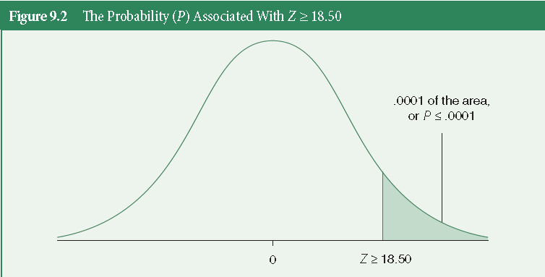
Probability Values
Notes:
Compare to back of book, appendix B, and see that the probability associated with getting a Z score (prob that falls beyond that z score) is below .0001. That means that our p-value (significance) for our z-score… is p < .0001. Means that our california data are significantly different from our national average. We’re looking for a p-value of less than .05... Meaning that we are willing to be wrong only 5% of the time.
This is the probability of obtaining our z score... That means that our z score is rare.
The smaller the p-value, the more evidence we have that the null hypothesis should be rejected.

Slide 18
Probability Values
Alpha (a)
The level of probability at which the null hypothesis is rejected
It is customary to set alpha at the .05, .01, or .001 level
If your obtained p-value is less that alpha (which is usually set at .05), then it’s safe to reject the null hypothesis.
Notes:
Our least strict level is .05, meaning that we are willing to be wrong 5% of the time… our most strict is .001, or .1% of the time.
If p is less than or equal to our alpha (.05), then we can say that our z score is statistically significant... It is unlikely to have occured by chance or sampling error.
IF we have a non-directional research hypothesis (h1 =/= value), This means that we mulitiply our p-value (associated with our z score, by 2. since we are looking in both tails of the distribution.

Slide 19
Hypothesis Testing Steps
Assumptions
Stating research and null hypotheses, selecting alpha
Selecting the sampling distribution and specifying the test statistic
Computing the test statistic
Making a decision and interpreting the results
Notes:
Assumptions: random sample, specify variable type (n,o,i), specify distribution of sample (normal if N>50)
Stating null and research hypotheses, and alpha: null: no relationship, research is specific, and alpha is always at least .05.
Selecting sampling distribution and test: sample is normal if over 50 cases, and the test statistic is based on the variable type you have. Chi, t-test, anova, and correlation.

Slide 20
Hypothesis Testing
Type I Error
Null is true, but you reject it
No relationship/no difference, but you say there is
Type II Error
Null is false, but you fail to reject
There is a relationship/difference, but you say there isn’t
Notes:
We can combat this by making our alpha more stringent (decreasing from .05, to .01, or .001)

Slide 21

The (one sample) t-Test
t statistic (obtained)
Because σ_{Y} is usually unknown, we estimate it by substituting with S_{Y}, which is known as the t-test.
The number of standard deviation units that our sample mean is from the hypothesized value of μ_{Y}
Notes:
Because we never really know the population parameters, we instead use the SD of the sample, and

Slide 22
The t-Test
t distribution
A family of curves, each determined by its degrees of freedom (the number of scores that are free to vary in calculating a statistic)
Used when the population standard deviation is unknown and the standard error is estimated from the sample standard deviation
df = N-1
Notes:
Df for t distribution is: N-1

Slide 23
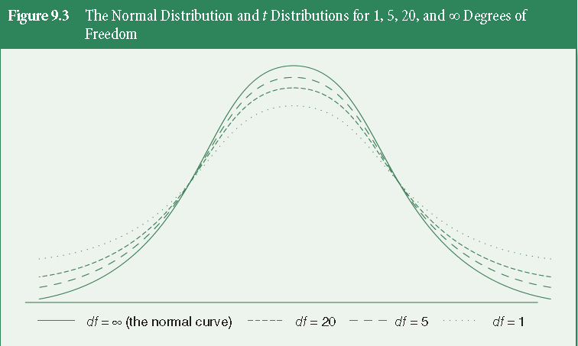
t distributions

Slide 24
Example: Mean Earnings of White Women
N = 320
Y = $36,471
S_{Y} = $28,563
μ_{Y} = $33,797
Notes:
We’re trying to find population mean earnings for white women.

Slide 25

Example: Mean Earnings of White Women
H₁: μ_{Y} ≠ $33,797
H₀: μ_{Y} = $33,797
df = (N-1) = 320-1 = 319
t = 1.67
Notes:
We’re trying to find population mean earnings for white women.

Slide 26
Example: Mean Earnings of White Women
Using our df and our obtained t, we can determine the significance between these
df = 319
t = 1.67
Notes:
We’re trying to find population mean earnings for white women.

Slide 27
Example: Mean Earnings of White Women
Next, we use our obtained t, and our degrees of freedom (df) and look up the significance level in Appendix C (p 484).
Using our df, we follow the table down that row and stop when we reach a value greater than our obtained t. Then go back one column.
Go up to that column, and report that value as your p-value (significance level).

Slide 28
Example: Mean Earnings of White Women
In our example, we have the following:
t = 1.67
df = (320-1) = 319
In our Appendix C, we follow the df = ∞ row, down to find a value greater than 1.67. Then go back one column.
If there is no value greater than your obtained value, use the final column.
Our p-value (our likelihood of being wrong) is less than .1 (less than 10 percent), but greater than our traditional cutoff of .05, since our t is not large enough to reach the next column.
P > .05

Slide 29
Reporting t
Report
The test used
If you reject or fail to reject the null hypothesis
The variables used in the analysis
The degrees of freedom, calculated value of the test, and p-value
t(df) = t value, p-value
“Using a one-sample t-test, I fail to reject the null hypothesis that there is no mean difference between our sample mean of women’s earnings and women’s mean earnings in the population, t(319) = 1.67, p > .05”
Notes:
Remember our Z scores? The ones associated with 95% confidence intervals and 99% confidence intervals? 1.96 and 2.58? Because the t-test is based on the same formula and similar distribution as the Z-statistic, we can use these values as a measure. If our t is greater than 1.96, we know that it is significant at (at least) the alpha=.05 level. So p<.05. If our t (or Z) is greater than 2.58, then we know its (at least) significant at the .01 level, so p<.01

Slide 30
The (two-sample/independent samples) t-Test
Difference Between Two Sample Means
Example: Average Education For Blacks versus Whites
H₀: There is no difference in mean education between Blacks and Whites
H₀: μ₁ = μ₂
H₁: There is a difference in mean education between Blacks and Whites
H₁: μ₁ ≠ μ₂
Notes:
More often, social scientists are more interested in looking at two parameters, between men and women, or between dems and republicans, or whites and non-whites.
We assume that our two samples, (blacks versus whites) are independent of one another)

Slide 31
The (two-sample/independent samples) t-Test
Tests about differences between two sample means based on…
Sampling distribution of difference between means
Theoretical probability distribution obtained by calculating all possibile mean differences created by drawing all possible independent random samples of size N₁ and N₂ from the two populations.
Provides estimate of the standard error between the two samples

Slide 32
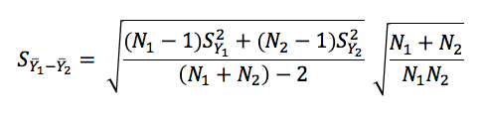

Estimating Standard Error for t-test
Assuming equal variance (for the samples):
Assuming unequal variance (for the samples):

Slide 33

The (two-sample/independent samples) t-Test
Difference Between Two Means
df = (N₁ + N₂) - 2
Notes:
More often, social scientists are more interested in looking at two parameters, between men and women, or between dems and republicans, or whites and non-whites.
We assume that our two samples, (blacks versus whites) are independent of one another)

Slide 34
t-Test and Confidence Intervals
The t-test is essentially creating a confidence interval around the difference score. Rearranging the above formula, we can calculate the confidence interval around the difference between two means:
If this confidence interval overlaps with zero, then we cannot be certain that there is a difference between the means for the two samples

Slide 35
Why a t Score and not a Z Score
Use of the Z distribution assumes the population standard error of the difference is known.
In practice, we have to estimate it and so we use a t score
When N gets larger than 50, the t distribution converges with a Z distribution so the results would be identical regardless of whether you used a t or Z

Slide 36
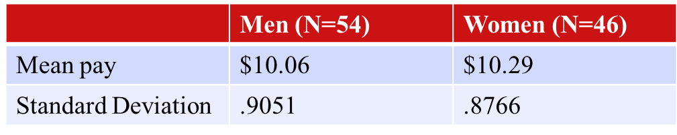
Example
What can we conclude about the difference in wages?

Slide 37
Key Terms
Alpha
Degrees of freedom
Left-tailed test
Null hypothesis
One-tailed test
P value
Research hypothesis
Right-tailed test
Sampling distribution of the difference between means
Statistical hypothesis testing

Slide 38
Key Terms
t distribution
t statistic
Two-tailed test
Type I error
Type II error
Z statistic (obtained)

